Slide 1
SOEN 341 week 1, 2
Introduction to the Software Process
An overview of some processes

Slide 2
The Software Development Process
Development of software on a commercial basis, particularly under contract, requires
a structure and organization that will :
  use the resources of the developer efficiently
  ensure that the product meets the requirements of the client in terms of:
    Function, Performance, and Reliability.
    (These three terms include much detail, ranging from usability to maintainability)

Slide 3
Software Process Phases
There are many different software processes, but they all share the same basic elements.
The difference is in how these elements are organized.
The classic process is sequential, and was called the waterfall process, because the implication was that each phase would feed into the next without further interaction.
See the next slide.

Slide 4
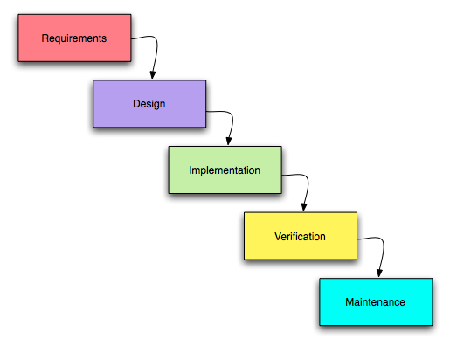
Waterfall Model

Slide 5
Waterfall and reality
In fact, lack of interaction is not practical, and never was.
  Much has been written criticizing the waterfall model, but in fact the original author never excluded interaction.
  It is useful, because it clearly defines sequence of events that is contractually verifiable and legally defensible, analogous to a large civil engineering project.

Slide 6
Waterfall in Software and Classic engineering
The problem is that software projects are never as well understood as classic engineering projects
For the purpose of this course, The deliverables of the project follow a waterfall like sequence, but within this frame, there is much scope for agile and iterative development.
We shall discuss all of this, but first the phases.

Slide 7
Discovery, planning, and risk
Discovery: This involves understanding thoroughly the problem, and reaching a clear agreement with the client on the deliverables. This starts with the domain model.
The layout of the process requires careful planning, and the plan of attack will depend on how confident the development team is on the product design, and the tools to be used in the project.

Slide 8
Elements of the process
Domain Analysis
  "Domain Analysis“ is the investigation of the so-called "domain" of the software, i.e. the nature of the project and its environment.
  This involves an understanding of what is being said by the client experts in in terms of the domain's own terminology
  This phase is an important prelude to extracting and gathering the requirements, and creating a correct specification.

Slide 9
Domain Model
See Domain Model Slides, Week 1

Slide 10
Risk
Risk refers to all areas of uncertainty, including the tasks to be performed and the capacity of the team members to achieve them
Now we will look at the different phases of development, once we have understood the domain.

Slide 11
Examples of Risk
Personnel
Schedule
Requirements, Scope
User Interface
Software Platform
Language
Framework

Slide 12
Frameworks
http://en.wikipedia.org/wiki/Software_framework
http://www.realsoftwaredevelopment.com/the-complete-list-of-software-development-frameworks-processs-methods-or-philosophies/
Recommended
http://www.hurricanesoftwares.com/most-popular-web-application-frameworks/

Slide 13
Process phases-1
Software Elements Analysis
  Extracting the requirements. Customers typically know what they want, but not what software should do. Demonstrating live code may help reduce the risk that the requirements are incorrect.
Scope Analysis
  An analysis of the scope of the development should be determined and clearly stated. Certain functionality may be out of scope of the development project as a function of cost or as a result of unclear requirements

Slide 14
Process phases-2 Specification
  Specification is the task of precisely describing the software to be written.
  Most successful specifications are written to understand and fine-tune applications that were already well-developed, although safety-critical software systems are often carefully specified prior to application development.
  Specifications are most important for external interfaces that must remain stable.

Slide 15
Specification concepts http://www.comptechdoc.org/independent/uml/begin/umldomainmodel.html
Nouns can be taken from the requirements definitions and use case drawings.
At this point all your use case drawings should be done.
If the object is required or is important to the use case, it should be included.

Slide 16
UseCases https://en.wikipedia.org/wiki/Use_case
A use case is a list of actions or event steps, typically defining the interactions between roles (an actor, or a system) to achieve a goal.
The actor can be a human or other external system.
Use case driven development is a key characteristic of many process models and frameworks.

Slide 17
Process phases-3
Software architecture
  Architecture :an abstract representation of th system.
  Architecture:
    The software system must meet the requirements of the product,
    It must ensure that future requirements can be addressed.
    addresses interfaces between the software system and other software products
    hardware or the host operating system

Slide 18
Process phases-4
Coding
  The most obvious part of the software engineering job, but it is not necessarily the largest portion.
Testing
  Testing parts of software developed by a team is the responsibility of the software engineer.
Implementation
  After the code is appropriately tested and approved, it is moved into production environment

Slide 19
Process phases-5
Documentation
  Documenting the internal design of software for the purpose of future maintenance and enhancement. Documentation is most important for external interfaces.
Software Training and Support
  The client organization must be able to use the system effectively.

Slide 20
Process phases-6
  Maintenance
  Maintaining and enhancing software to cope with newly discovered problems or new requirements (can take far more time than the initial development of the software).
  A small part is fixing bugs. Most maintenance is extending systems to do new things
  In comparison, about ⅔ of all civil engineering, architecture, and construction work is also maintenance in a similar way.

Slide 21
Some process models
The Waterfall process
The Spiral process
Rational Unified Process
Other types:
Iterative processes
Agile processes

Slide 22
Waterfall Phases
In the original waterfall model, the following phases are followed in order:
  Requirements specification
  Design
  Construction (AKA implementation or coding)
  Integration
  Testing and debugging (AKA validation)
  Installation
  Maintenance

Slide 23
Waterfall Details-1
First complete the "requirements specification"
Then do the design. The software in question is designed and a "blueprint" is drawn for implementers (coders) to follow — this design should be a plan for implementing the requirements given.
When the design is fully completed, an implementation of that design is made by coders.

Slide 24
Waterfall Details-2
In the later stages of the implementation phase, software components produced by different teams are integrated.
After the implementation and integration phases are complete, the software product is tested and debugged; any faults introduced in earlier phases are removed here.
Then the software product is installed, and later maintained to introduce new functionality and remove bugs.

Slide 25
The original theory
The common understanding of the classical waterfall model maintains that one should move to a phase only when its preceding phase is completed and perfected.
Phases of development in the waterfall model are discrete, and there is no jumping back and forth or overlap between them

Slide 26
Discussion of waterfall
2.1 The Waterfall Model as a Process
The waterfall model describes a process for software development.
The Waterfall Model is document driven. Each step of the process yields documents.
For example, when Requirements Analysis has been completed, there is a Requirements Document. Before coding starts, there must be a set of Design Documents.

Slide 27
Waterfall
Documents produced during one step are needed for the next step and possibly for later steps.
For example, the Requirements Document is needed for design, the next step.
Later, the Requirements Document is needed to ensure that the developed product meets the requirements during Acceptance Testing.

Slide 28
Waterfall and Management
Managers like the waterfall model because progress is observable and measurable.
The transitions between steps become project “milestones” that indicate progress made.
Documents are tangible evidence of progress.

Slide 29
Waterfall and Management
We can assign people with different skills to the various phases. The waterfall model suggests roles such as:
  – analyst (also called “systems analyst”);
  – designer;
  – programmer (now called “development engineer”);
  – tester (now called “test engineer”;
  – trainer;
  – maintainer (now called “maintenance engineer”).

Slide 30
Cost Estimation
We can estimate cost by adding the estimated costs of each phase and then adding a safety factor.
A problem is that we may not have enough information during the early phases to make accurate predictions about the effort needed, and hence the cost, of later phases.
Many software projects fail because of cost overruns. The suppliers estimate $3 million and, when they have spent $6 million, the clients cancel the contract and expensive law suits follow.

Slide 31
Prescription and Description
There are two kinds of models.
A prescriptive model describes what ought to be done
A descriptive model describes what actually happens
The waterfall model was introduced as a descriptive model: it was intended to describe what happens in engineering projects and to use these observations for future projects.
The waterfall model became a prescriptive model: it proposes a method for software development that is hard to follow exactly and has several problems when it is followed exactly.

Slide 32
Why is the waterfall a poor model?
The waterfall model is based on classical engineering practice but it is not clear that experience gained from construction of physical objects is going to work for software development.
The waterfall model is driven by documents. Documents may reflect what readers want to hear rather than what is actually happening.

Slide 33
Classical vs Software Engineering
A classical view compares building a bridge, to constructing a software product. The waterfall model works for bridges because bridge-building is well-understood
The reasons that it does not work for programming :
  the software development process is not well-understood;
  scientific foundations are lacking;
  software requirements change.

Slide 34
Waterfall Model
The Model proposed by Royce was actually more flexible and better adapted to software development than subsequent interpretations of the concept.
See the following

Slide 35
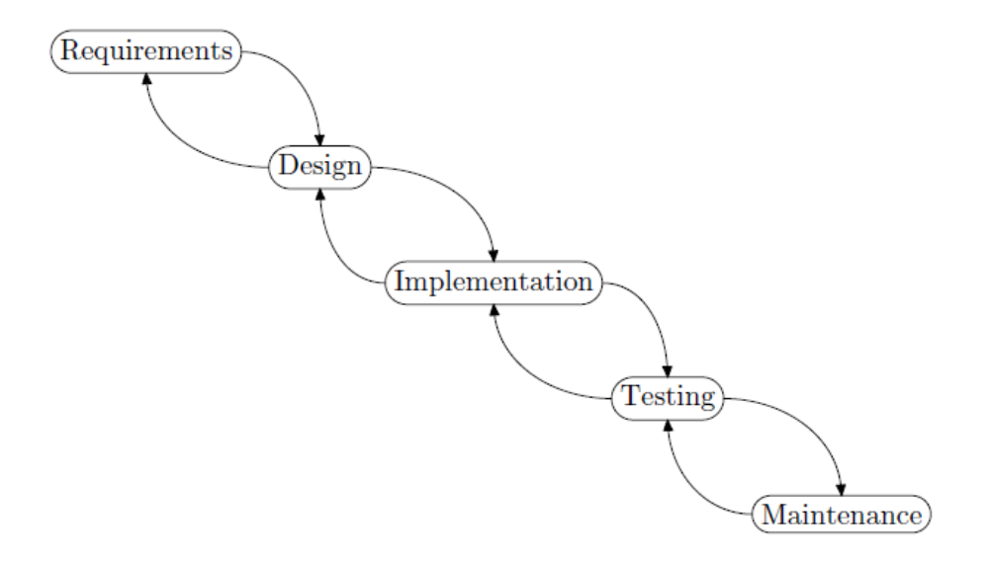

Slide 36
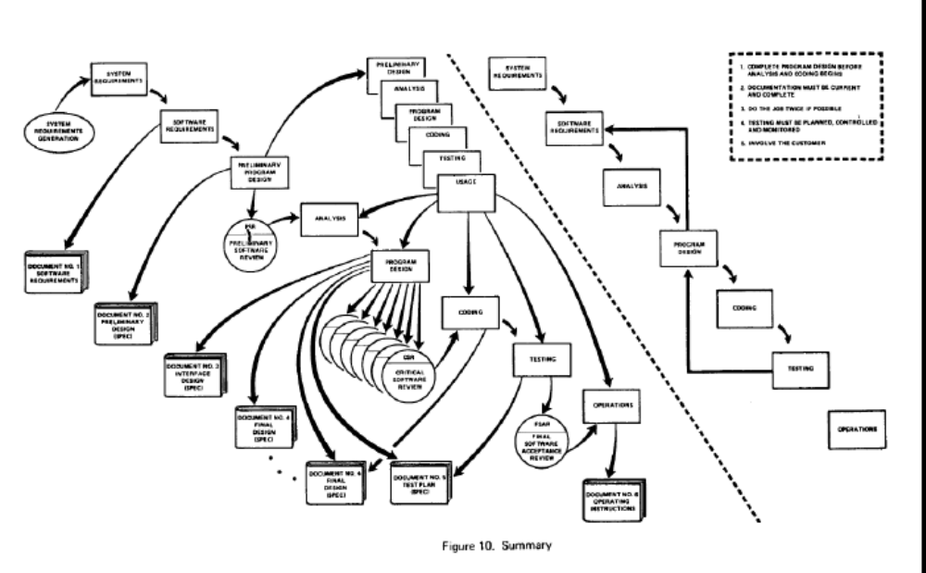

Slide 37
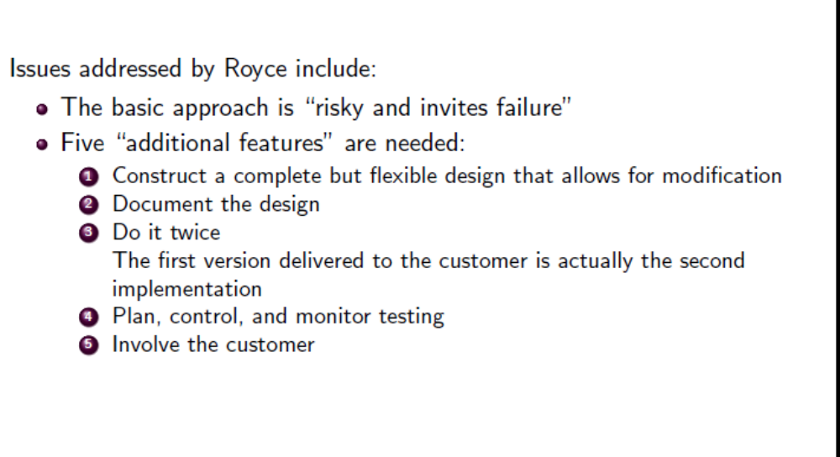

Slide 38
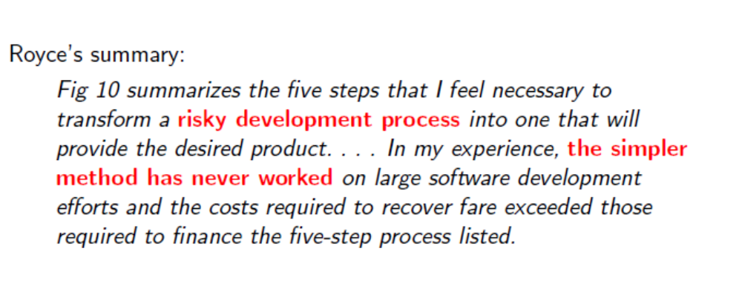

Slide 39
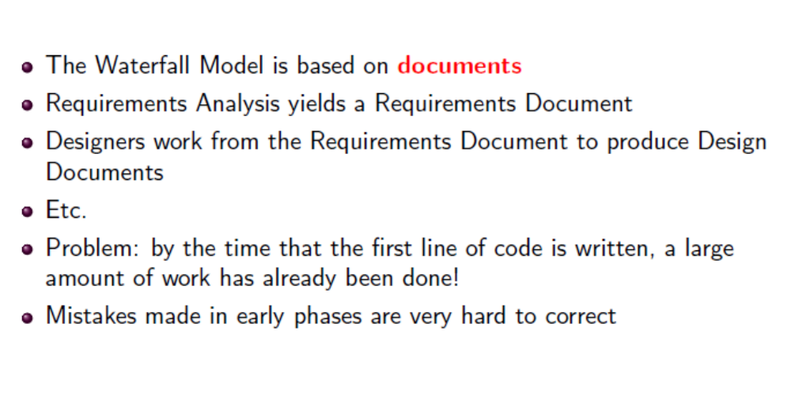

Slide 40
Phases
Although the waterfall model in its conventional form does not work well, the phases defined are essential for any large software project.
However, they should not necessarily be applied one at a time in a particular order.

Slide 41
Other Approaches
Building software
The “building” metaphor: planning; specification as blueprint; components; assembly; scaffolding; etc. But the idea that planning preceded construction remained.
Growing software rather than build it.
Start with a very simple system that runs but has minimal functionality and then add to it and let it grow.
Ideally, the software grows like a flower or a tree; occasionally, however, it may spread like weeds.

Slide 42
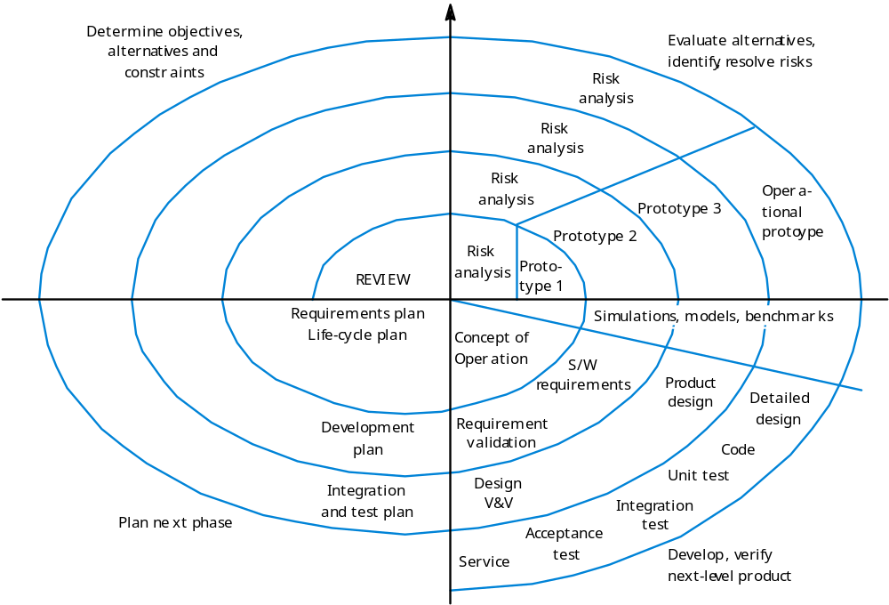
Spiral Model

Slide 43
The spiral model-1
Each phase starts with a design goal and ends with the client reviewing the progress thus far. Analysis and engineering efforts are applied at each phase of the project, with an eye toward the end goal of the project
The spiral model combines the features of the prototyping model and the waterfall model. It is intended for large, expensive, and complicated projects.

Slide 44
The spiral model-2
The preceding steps are iterated until the customer is satisfied that the refined prototype represents the final product desired.
The new system requirements are defined in as much detail as possible.
A preliminary design is created for the new system.
A first prototype of the new system is constructed from the preliminary design. ( a scaled-down system, an approximation of the of the final product).

Slide 45
The spiral model-3
A second prototype is evolved by a fourfold procedure:
  (1) evaluating the first prototype in terms of its strengths, weaknesses, and risks;
  (2) defining the requirements of the second prototype;
  (3) planning and designing the second prototype;
  (4) constructing and testing the second prototype.

Slide 46
The spiral model-4 RISK
At the customer's option, the entire project can be aborted if the risk is deemed too great.
Risk factors might involve
  development cost overruns,
  operating-cost miscalculation,
  any other factor that could, in the customer's judgment, result in an unsatisfactory final product.

Slide 47
The spiral model-5
The new prototype is evaluated in the same manner as the previous prototype.
If necessary, another prototype is developed from it according to the fourfold procedure outlined above.
These steps are iterated until the customer is satisfied.
The final system is constructed, based on the refined prototype. The final system is thoroughly evaluated and tested.

Slide 48
Incremental Development
The fancy name for growing software is incremental development. Advantages of incremental development:
there is a working system at all times;
clients can see the system and provide feedback
progress is visible, rather than being buried in documents;
some kinds of errors can be avoided.

Slide 49
Incremental Disadvantages
Incremental development also has some disadvantages:
  design errors become part of the system and are hard to remove;
  clients see possibilities and want to change requirements.

Slide 50
Errors
In general a process model must recognize the possibility of errors and provide ways of correcting them
errors made early in development tend to be more serious (that is, more expensive to fix) than errors made later
the kind of errors made depend to some extent on the process model.
As an example, consider an error in the requirements. With the waterfall model, the error may not be noticed until acceptance testing, when it is probably too late to correct it. (Note that the client probably does not see the software running until the acceptance tests.)

Slide 51
Avoidance of Errors
There are claims that an error in requirements costs 100 times (or 1,000 times, or “exponentially more”) than an error in coding.
These claims have not been substantiated.
It is true that, in a large project, the earlier that errors are caught, the better.
Modern techniques, such as incremental development and prototyping, however, avoid these extreme situations.

Slide 52
incremental model
In the incremental model, requirements errors can be recognized as the corresponding software is incorporated into the system. It is then easy to correct it.
The waterfall model relies on careful review of documents to avoid errors.
Once a phase has been completed, there is no stepping back. It is difficult to verify documents precisely

Slide 53
The Iterative process characteristics
Iteration prescribes the construction of initially small but ever larger portions of a software project to help uncover important issues early before problems or faulty assumptions can lead to disaster.
Iterative processes have the potential of reaching the design goals of customers who do not know how to define what they want.

Slide 54
Iterative Challenges
Software architects are still faced with the challenge of creating a reliable foundation upon which to develop.
Such a foundation often requires a fair amount of upfront analysis and prototyping to build a development model.
The development model often relies upon specific design patterns and entity relationship diagrams (ERD).
Without this upfront foundation, Iterative development can create long term challenges that are significant in terms of cost and quality

Slide 55
Agile Process Characteristic
Agile software development processes are built on the foundation of iterative development.
They use a lighter, more people-centric approach. They use feedback, rather than planning, as their primary control mechanism. The feedback is driven by regular tests and releases of the evolving software.

Slide 56
Agile Processes-2
They seem to be more efficient than older methodologies,
  using less programmer time to produce more functional, higher quality software,
  but have the drawback from a business perspective that they do not provide long-term planning capability
The Agile approach claims it will provide the most bang for the buck, but won't say exactly when that bang will be or how big a buck will ultimately be required.

Slide 57
Project Discussion
Full information on the project specifications and the definition of the intermediate and final deliverables can be found in the folder “Project Specifications” in the initial section of the Moodle site.
Team size should normally be 10 students, but not less than 8.
Teams must select a team leader, who will be responsible for communication with the instructor, the tutor, and the course coordinator.

Slide 58
The Project Submission 0
Domain Analysis
Domain Description
This is a brief (2 to 3 page) description of the project, with text and diagrams
It constitutes the Domain analysis of the project, and may be written as a hierarchical expansion of the problem statement.

Slide 59
Intermediate Submissions
Submissions.
At the end of each time box, teams will submit the documents they have prepared to the instructor.
The purpose of the submissions is to give the instructor and the tutor an opportunity to see and evaluate the work, and to discuss the project informally with the team.

Slide 60
Project - Final Submission.
To complete the project, after the final time box, each team must submit the following documents:
1. A User Manual explaining how to operate the program from a user’s perspective.
2. Design Documentation, as described above, integrated and modified in the light of experience to constitute a complete design.
3. Implementation Notes describing particular features of the implementation, problems encountered and how they were solved, etc.
4. Testing Report
5. Complete source code.
5. Individual report
Team members must submit an individual report of their own experience in working on the project: what they contributed, what was easy, what was hard, any disagreements, etc.
For items 1 through 4 above, all members of a team will receive the same mark.

Slide 61
Some references
Somerville slides
  cc.ee.ntu.edu.tw/~farn/courses/SE/ch4.ppt
Wikipedia=excellent overview
  https://en.wikipedia.org/wiki/Software_development_process
Team Software process-Wiki
  https://en.wikipedia.org/wiki/Team_software_process

